Slide 1
Secure data hiding in images using steganography
CAPSTONE PROJECT
Presented By: Deepam Kochar
Student Name : Deepam Kochar
College Name & Department : Suresh Gyan Vihar University

Slide 2
OUTLINE
Problem Statement
Technology used
Wow factor
End users
Result
Conclusion
Git-hub Link
Future scope

Slide 3
Problem Statement
With the rise in cyber threats, securing sensitive information is crucial. Traditional encryption methods can attract suspicion, making them vulnerable to attacks. Steganography provides a way to hide data within images, ensuring secrecy. However, existing techniques struggle with capacity, imperceptibility, and robustness. This project aims to develop a secure and efficient stenographic method that enhances data hiding while maintaining image quality and resistance to detection.

Slide 4
Technology used
Platform: Python IDLE
Libraries:
OpenCV: For image processing and manipulation.
NumPy: For handling and manipulating image arrays.
PIL (Pillow): For image handling and operations.
Cryptography: For encrypting and securing the hidden messages.

Slide 5
Wow factors
Dual-layer Security: Combines encryption with hidden messages for extra protection.
Historical Use: Steganography dates back to ancient times, including use in wartime espionage.
Modern Applications: Used in digital forensics, copyright protection, and more.
Invisibility: Messages can be hidden within images without visible changes.
Open Source Power: Libraries like OpenCV make image processing accessible and powerful.

Slide 6
End users
Government & Military – Secure communication for classified information.
Journalists & Whistleblowers – Safely transmitting sensitive data without detection.
Cybersecurity Experts – Protecting confidential data from hackers and surveillance.
Law Enforcement Agencies – Covertly sharing intelligence and investigation details.
Businesses & Corporations – Securing trade secrets, financial reports, and confidential documents.
Medical Institutions – Safeguarding patient records and medical images.
Banking & Finance Sector – Secure transactions and communication of sensitive financial data.

Slide 7

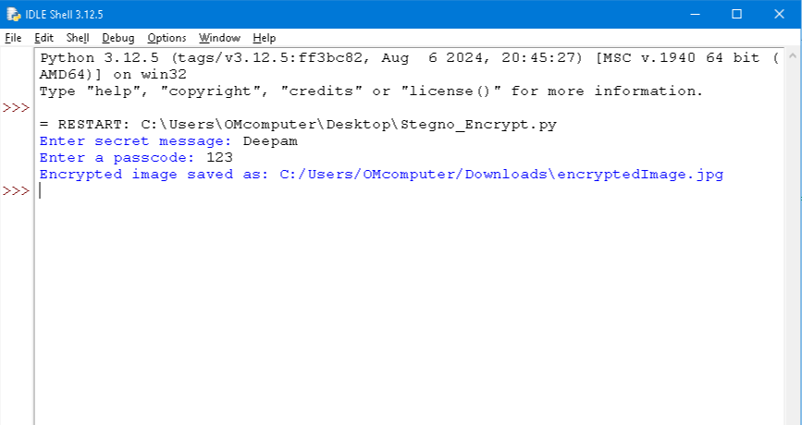
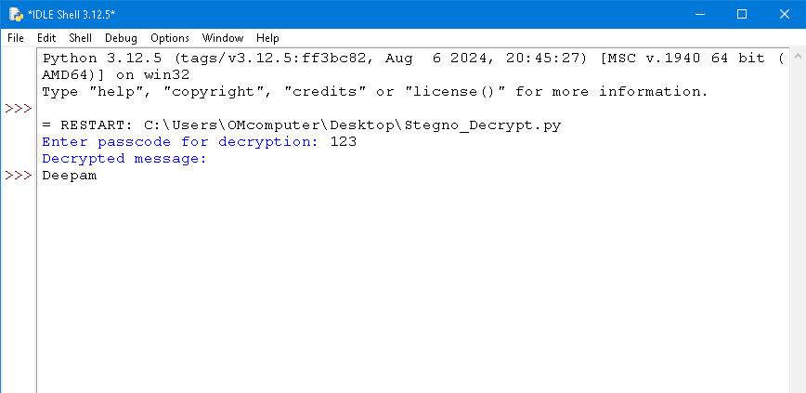

Results

Slide 8
Conclusion
This project enhances secure data hiding using steganography by integrating advanced techniques like LSB, DCT, and AES encryption. It ensures high capacity, imperceptibility, and resistance to detection, making it ideal for secure communication and data protection. The system offers a reliable solution for cybersecurity, government, and corporate applications, with future potential for AI-driven improvements.

Slide 9
GitHub Link
https://github.com/Deepamkochar/Stegnography_Project.git

Slide 10
Future scope(optional)

Slide 11
THANK YOU

